Slide 1
Topological Data Analysis
Joshua Sheldon, Justin Barnwell, Michelle Arubi

Slide 2
Outline
Intro to TDA
Data & Objective
Implementation & Results

Slide 3
Intro to TDA
The science of shapes

Slide 4
Shaping Up
0
9
6
Notes:
Intuitively we know that 9, 0, and 6 are somewhat similar in shape

Slide 5

Transformers
9
9
6
Rotate 180°
6
Add/Remove
Segments
6
0
New Number
Notes:
There’s definite operations we can use to get from one number to another

Slide 6
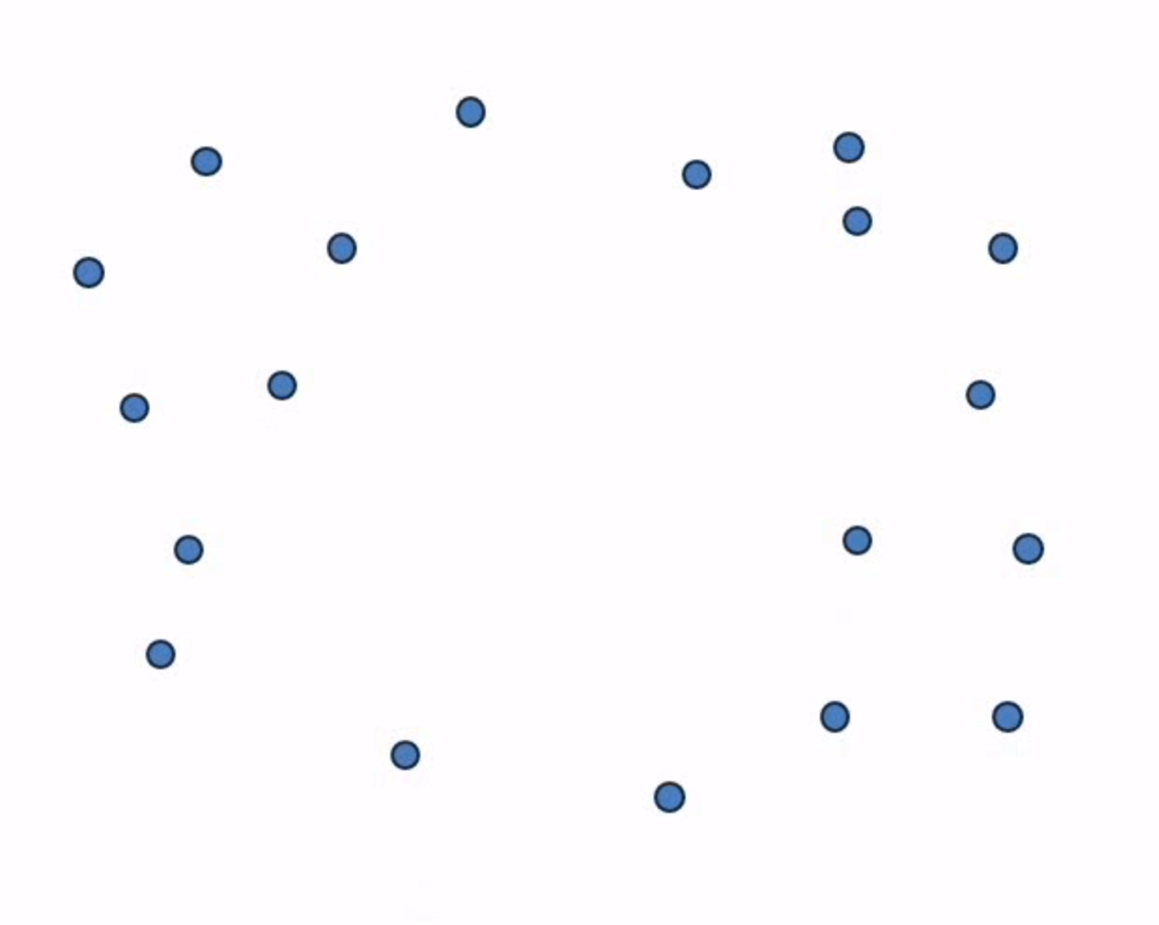
Topological Data Analysis
to·pol·o·gy
The way in which constituent parts are interrelated or arranged
The study of geometric properties and spatial relations unaffected by the continuous change of shape or size of figures
What shape?
Notes:
However, that’s not universally applicable
So, we have the science of topology
Take this point cloud, what features or shapes define these points?
Definition from Oxford Languages
Picture from https://www.youtube.com/watch?v=h0bnG1Wavag

Slide 7
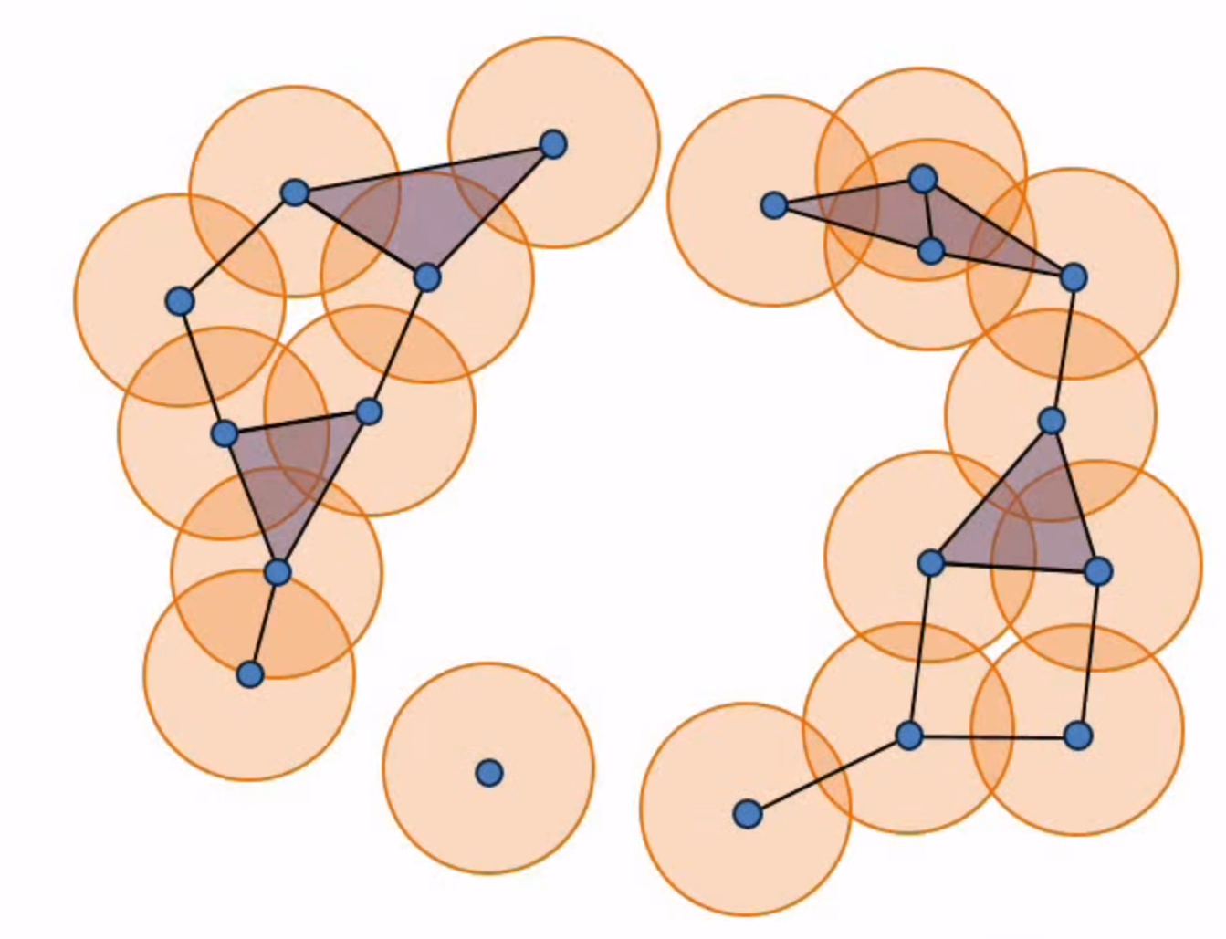
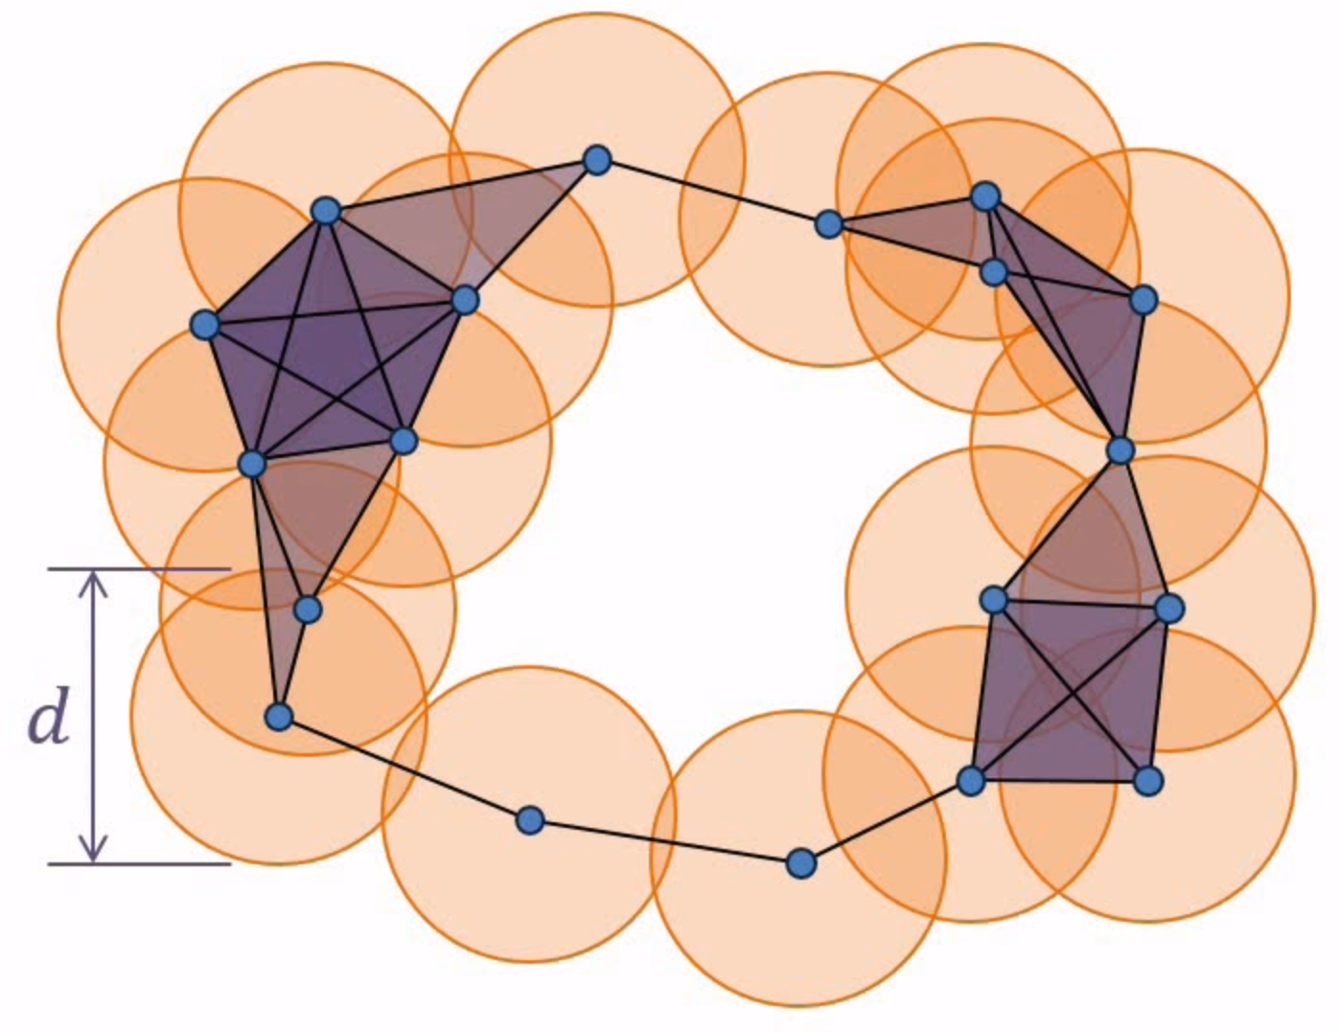
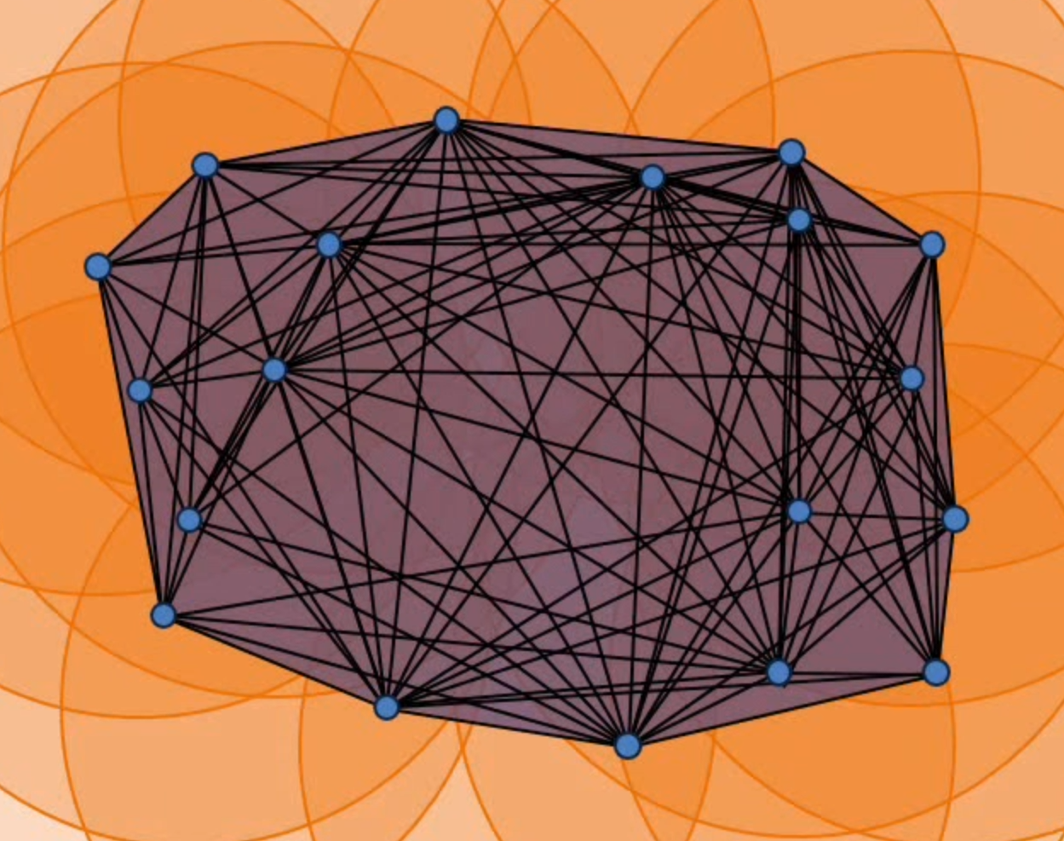
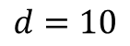
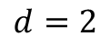
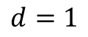
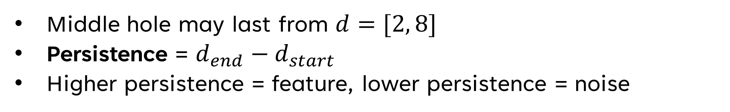
Persistent Homology
$$d=1$$
$$d=2$$
$$d=10$$
Middle hole may last from $d=[2, 8]$
Persistence = $d_{end}−d_{start}$
Higher persistence = feature, lower persistence = noise
Notes:
One way of seeing what geometric features define this data is by drawing circles around each point, and increasing their diameter (d)
When circles overlap, edges are formed between the points.
And you see these points and edges form shapes as d changes.
So for instance this middle circle here could last when d is in the range [2, 8]
The idea is that the larger the range of d, the more important the shapes are
This helps us extract important features from the data
This technique is called persistent homology
Pictures from https://www.youtube.com/watch?v=h0bnG1Wavag

Slide 8
Now What?
Point clouds = data sets
Using homology, we acquire important features of our data.
We can reduce the dimensionality of data while maintaining important features.
Reduced dimensionality makes data analysis possible!
Notes:
Once we know the important features of data, we can reduce the dimensionality of the data while maintaining
Now with reduced dimensionality, we can make data analysis easier with structures like covers, graphs, etc.

Slide 9
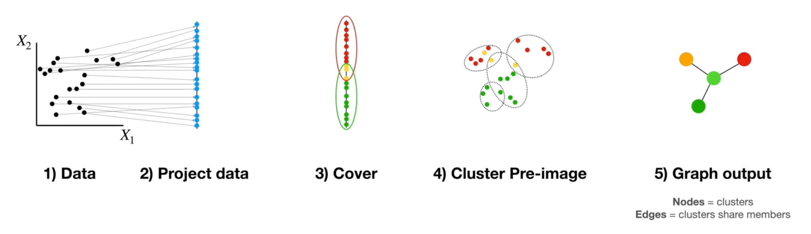
Mapper Algorithm
Notes:
The mapper algorithm is a way we can analyze the relationships between data
We reduce the dimensionality of the data
Make clusters (covers of data points)
Create a graph where clusters are nodes and edges are where the clusters share members
Picture from https://www.youtube.com/watch?v=NlMrvCYlOOQ

Slide 10
Data & Objective
Digit data with detracted dimensionality

Slide 11
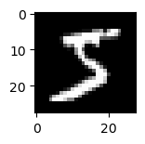
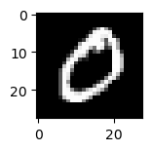
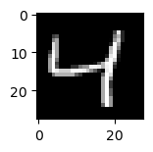
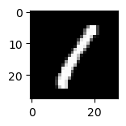
MNIST
Library of grasycale handwritten digit images.

Slide 12

MNIST Digit Example
[[ 0 0 0 0 0 0 0 0 0 0 0 0 0 0 0 0 0 0 0 0 0 0 0 0 0 0 0 0]
[ 0 0 0 0 0 0 0 0 0 0 0 0 0 0 0 0 0 0 0 0 0 0 0 0 0 0 0 0]
[ 0 0 0 0 0 0 0 0 0 0 0 0 0 0 0 0 0 0 0 0 0 0 0 0 0 0 0 0]
[ 0 0 0 0 0 0 0 0 0 0 0 0 0 0 0 0 0 0 0 0 0 0 0 0 0 0 0 0]
[ 0 0 0 0 0 0 0 0 0 0 0 0 0 0 0 0 0 0 0 0 0 0 0 0 0 0 0 0]
[ 0 0 0 0 0 0 0 0 0 0 0 0 3 18 18 18 126 136 175 26 166 255 247 127 0 0 0 0]
[ 0 0 0 0 0 0 0 0 30 36 94 154 170 253 253 253 253 253 225 172 253 242 195 64 0 0 0 0]
[ 0 0 0 0 0 0 0 49 238 253 253 253 253 253 253 253 253 251 93 82 82 56 39 0 0 0 0 0]
[ 0 0 0 0 0 0 0 18 219 253 253 253 253 253 198 182 247 241 0 0 0 0 0 0 0 0 0 0]
[ 0 0 0 0 0 0 0 0 80 156 107 253 253 205 11 0 43 154 0 0 0 0 0 0 0 0 0 0]
[ 0 0 0 0 0 0 0 0 0 14 1 154 253 90 0 0 0 0 0 0 0 0 0 0 0 0 0 0]
[ 0 0 0 0 0 0 0 0 0 0 0 139 253 190 2 0 0 0 0 0 0 0 0 0 0 0 0 0]
[ 0 0 0 0 0 0 0 0 0 0 0 11 190 253 70 0 0 0 0 0 0 0 0 0 0 0 0 0]
[ 0 0 0 0 0 0 0 0 0 0 0 0 35 241 225 160 108 1 0 0 0 0 0 0 0 0 0 0]
[ 0 0 0 0 0 0 0 0 0 0 0 0 0 81 240 253 253 119 25 0 0 0 0 0 0 0 0 0]
[ 0 0 0 0 0 0 0 0 0 0 0 0 0 0 45 186 253 253 150 27 0 0 0 0 0 0 0 0]
[ 0 0 0 0 0 0 0 0 0 0 0 0 0 0 0 16 93 252 253 187 0 0 0 0 0 0 0 0]
[ 0 0 0 0 0 0 0 0 0 0 0 0 0 0 0 0 0 249 253 249 64 0 0 0 0 0 0 0]
[ 0 0 0 0 0 0 0 0 0 0 0 0 0 0 46 130 183 253 253 207 2 0 0 0 0 0 0 0]
[ 0 0 0 0 0 0 0 0 0 0 0 0 39 148 229 253 253 253 250 182 0 0 0 0 0 0 0 0]
[ 0 0 0 0 0 0 0 0 0 0 24 114 221 253 253 253 253 201 78 0 0 0 0 0 0 0 0 0]
[ 0 0 0 0 0 0 0 0 23 66 213 253 253 253 253 198 81 2 0 0 0 0 0 0 0 0 0 0]
[ 0 0 0 0 0 0 18 171 219 253 253 253 253 195 80 9 0 0 0 0 0 0 0 0 0 0 0 0]
[ 0 0 0 0 55 172 226 253 253 253 253 244 133 11 0 0 0 0 0 0 0 0 0 0 0 0 0 0]
[ 0 0 0 0 136 253 253 253 212 135 132 16 0 0 0 0 0 0 0 0 0 0 0 0 0 0 0 0]
[ 0 0 0 0 0 0 0 0 0 0 0 0 0 0 0 0 0 0 0 0 0 0 0 0 0 0 0 0]
[ 0 0 0 0 0 0 0 0 0 0 0 0 0 0 0 0 0 0 0 0 0 0 0 0 0 0 0 0]
[ 0 0 0 0 0 0 0 0 0 0 0 0 0 0 0 0 0 0 0 0 0 0 0 0 0 0 0 0]]
28x28 matrix of numbers [0, 255]
(8 bit unsigned ints)
0
255
Notes:
MNIST images are 28 x 28 images, with each pixel being represented by a number from 0 to 255
The lower the number the closer to black, the higher the number the closer to white

Slide 13
Our Objective
Select 10 MNIST images for each digit (100 total)
Analyze them with the Mapper algorithm
Visualize the relationships between digits
Notes:
Preferably we want each digit to be a node

Slide 14
Implementation & Results
You’re in the weeds: beware Pythons

Slide 15


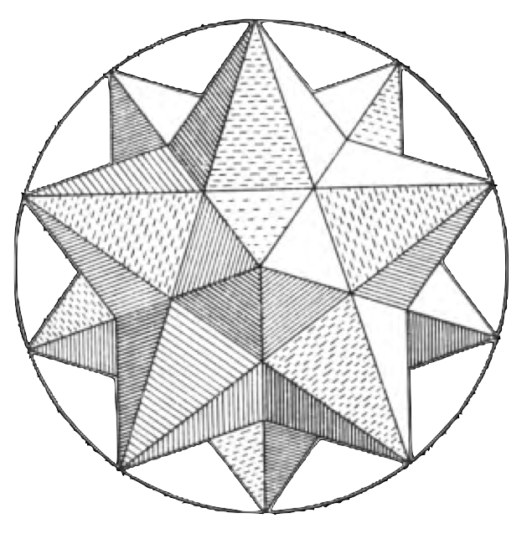




Tech Stack
Notes:
Python is the premier lang for data science operations
Jupyter notebooks allow for quick visualization of our output
KeplerMapper provides the implementation of the mapper algorithm
Matplotlib allows us to visualize data points, MNIST digits, etc.
NumPy is useful for its data structures and data reshaping functionality
Keras provided the MNIST data set
Scikit learn provided many of the tools for data projection, and also created KeplerMapper I think

Slide 16
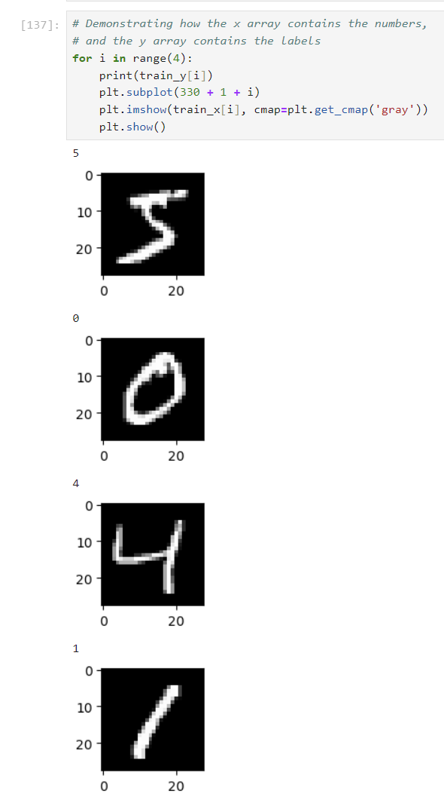
Importing MNIST
Keras provides the MNIST dataset through 4 arrays:
x_train : (60000,28,28)
y_train : (60000,)
x_test : (60000,28,28)
y_test : (60000,)
x = image data
y = labels
Notes:
The x arrays contain the 28 x 28 matrices for each image in them
The y arrays contain the labels for each image in the x arrays
We arbitrarily chose to use the train arrays

Slide 17
Storing Digits
Converting 28x28 matrices to 784-dimension vectors
Three new data structures
data : array(100,784)
labels : array(100,)
Notes:
We need data points, so we’re going to convert our 28x28 matrices into 784-dimension vectors so they can be projected into 2D vectors (like on a typical Cartesian graph (x, y))
So we’ll have our actual data points and the label for each data point

Slide 18
Selection Algorithm
# Keep track of how many of each digit we’ve collected
added = new size 10 array, initialized to 0s
# Select digits
old_index = 0 # For traversing through Keras MNIST arrays
new_index = 0 # For traversing through our arrays
while not all(value == 10 for value in added):
digit = train_y[old_index]
if added[digit] < 10:
# Add label in format: <digit> (#<occurrence>)
labels.append(label)
# Reduce dimensionality and add to array
data[new_index] = train_x[old_index].reshape(-1)
# Increment occurrences of digit and position in data array
added[digit] += 1
new_index += 1
old_index += 1
Notes:
This algorithm helps us pick 10 images from each digit to add to our analysis dataset
Theoretically you could select a different part of the data set by starting old_index at a different value

Slide 19
Reducing Dimensionality
Now we apply a series of projections to reduce our data from 784 dimensions to 2.
Example:
Isometric Mapping – 784 -> 100
UMAP* – 100 -> 2
Other popular projections: PCA, t-SNE, Feature Scaling
Each projection may have different strengths/objectives.
Notes:
UMAP = Uniform Manifold Approximation and Projection for Dimension Reduction

Slide 20
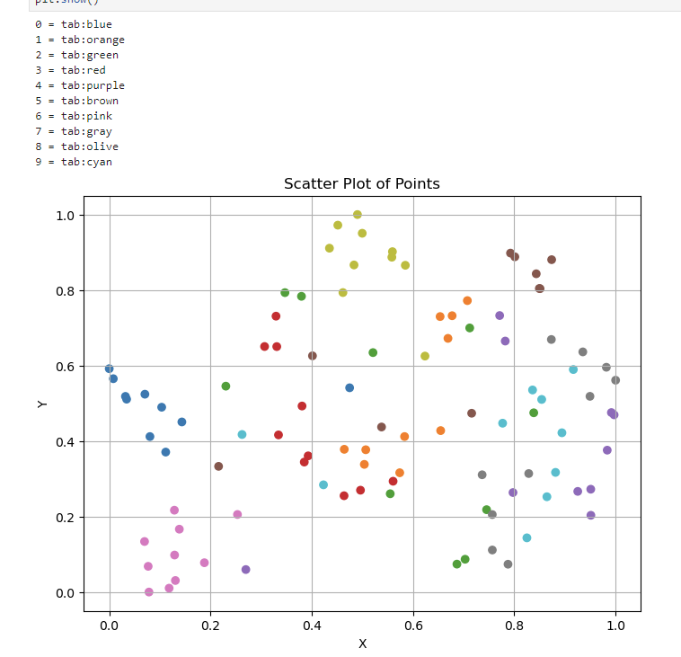
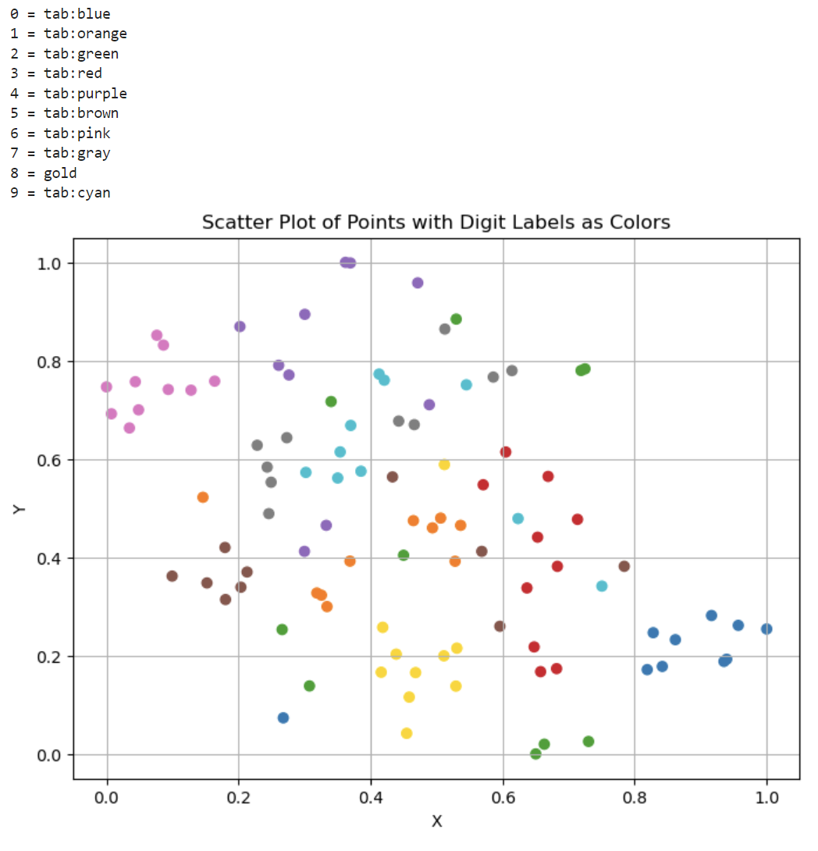
Projection as a Lens
Pipeline 1
Isometric Mapping
UMAP
Pipeline 2
MinMax Scaler
T-SNE
Notes:
The pipeline of projections changes the end result
Projection is the “lens” through which you see your data

Slide 21
Cover, Cluster, and Graph
Now that our data is in 2 dimensions, we can create a cover, cluster the data, and construct a graph.
Will refer to these operations as mapping.
We tried two types of mapping: informed and uninformed.
The difference between these two is knowledge of the digit that each data point represents.

Slide 22
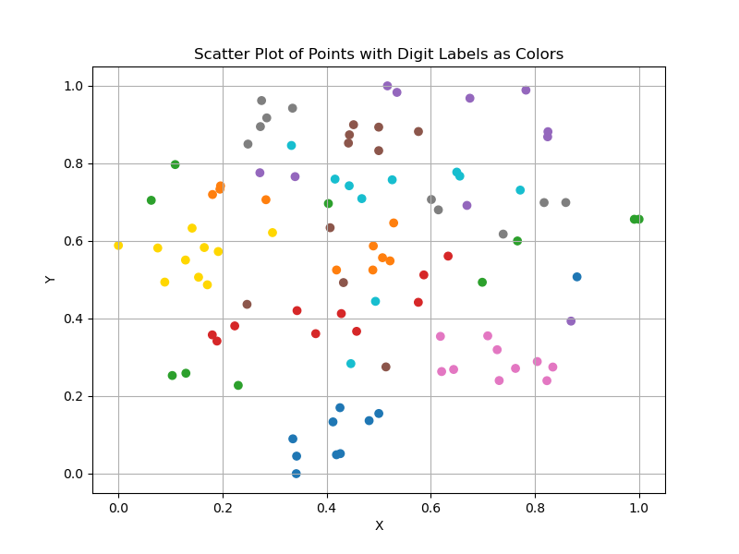
Manual Mapping
Step 1: Create concave hulls around all points of a digit.

Slide 23
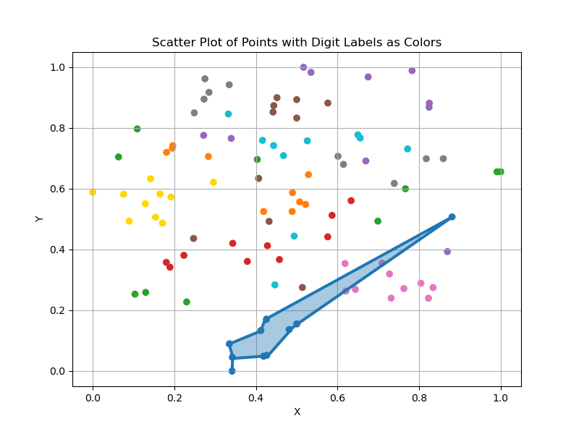
Manual Mapping
For 0

Slide 24
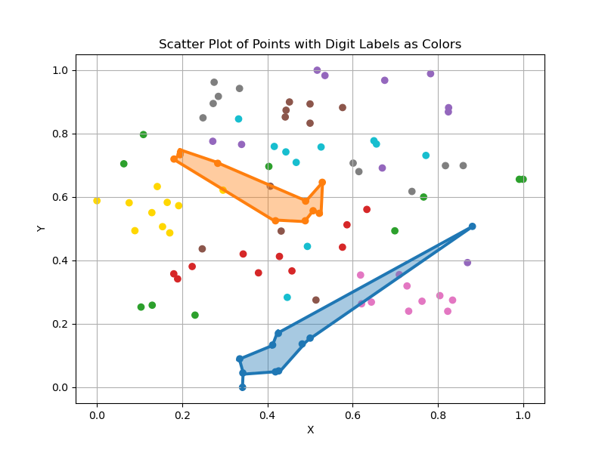
Manual Mapping
For 1

Slide 25
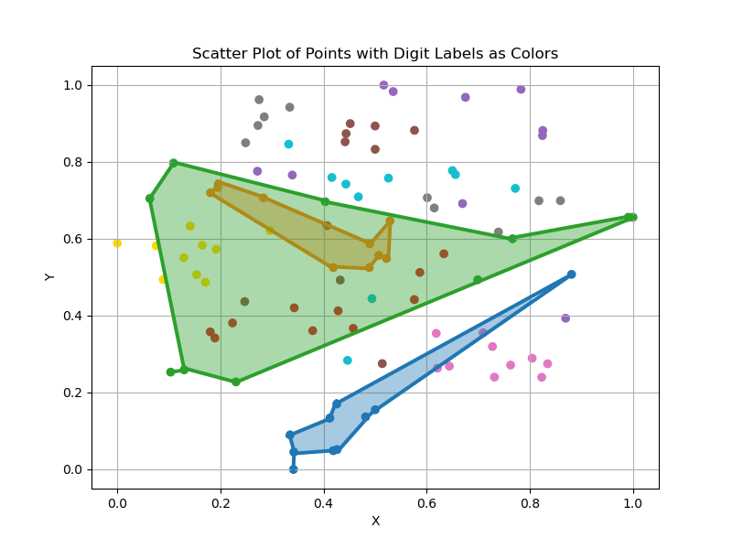
Manual Mapping
For 2

Slide 26
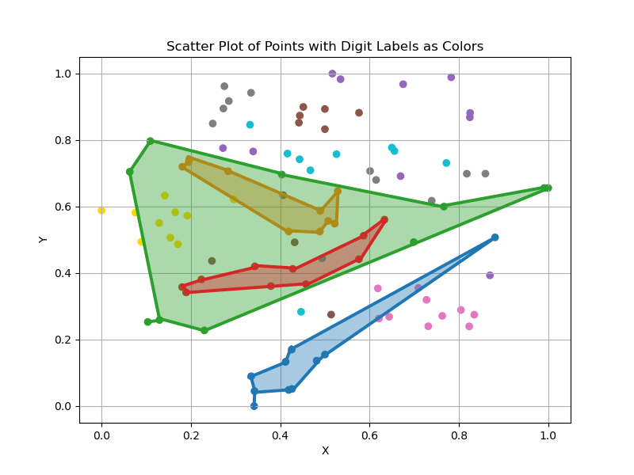
Manual Mapping
For 3

Slide 27
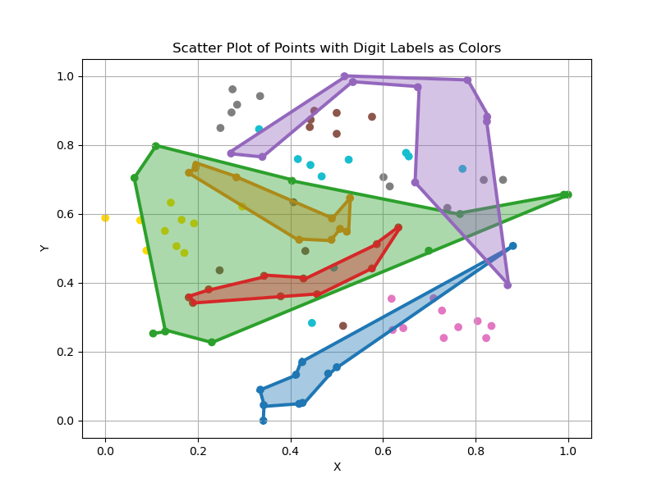
Manual Mapping
For 4

Slide 28
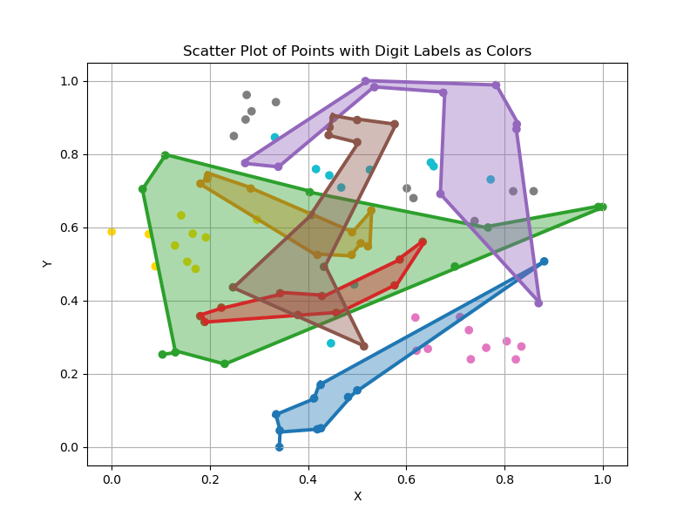
Manual Mapping
For 5

Slide 29
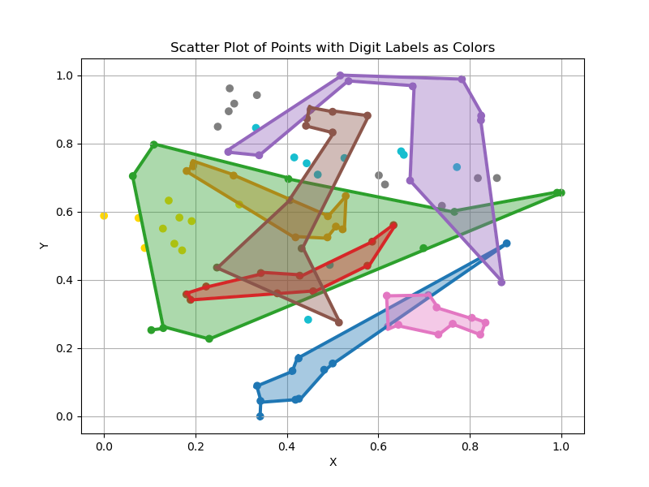
Manual Mapping
For 6

Slide 30
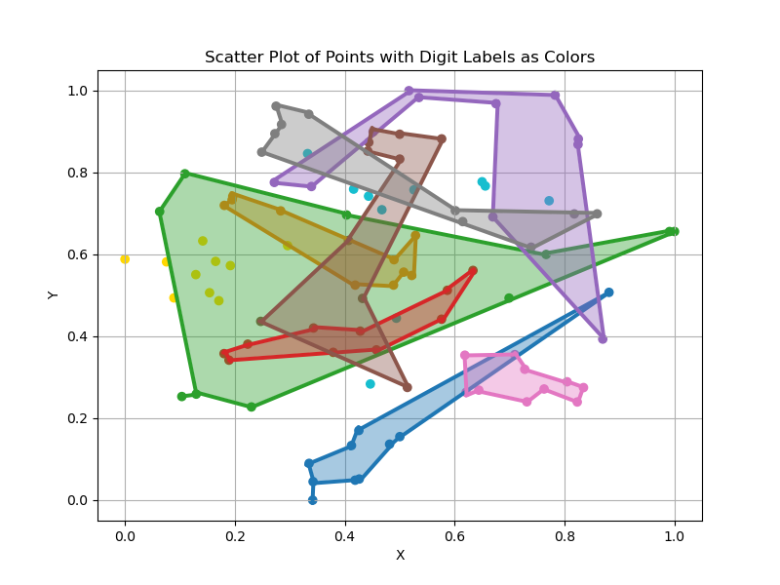
Manual Mapping
For 7

Slide 31
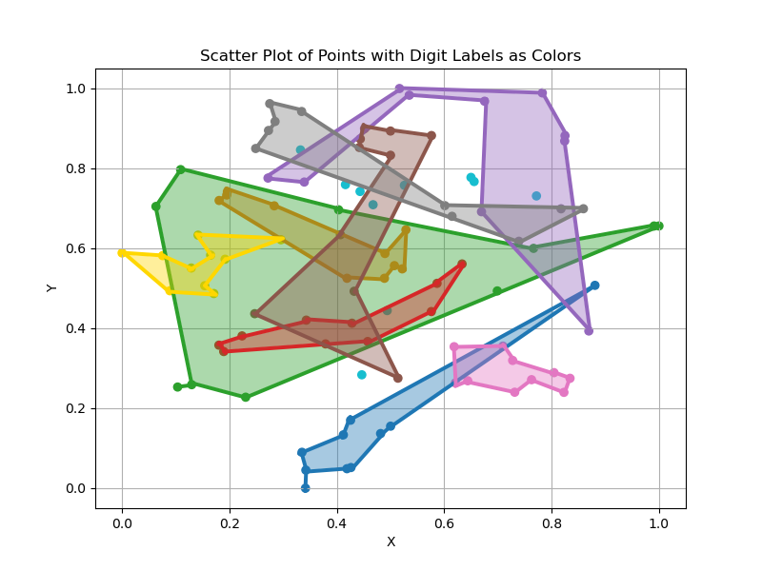
Manual Mapping
For 8

Slide 32
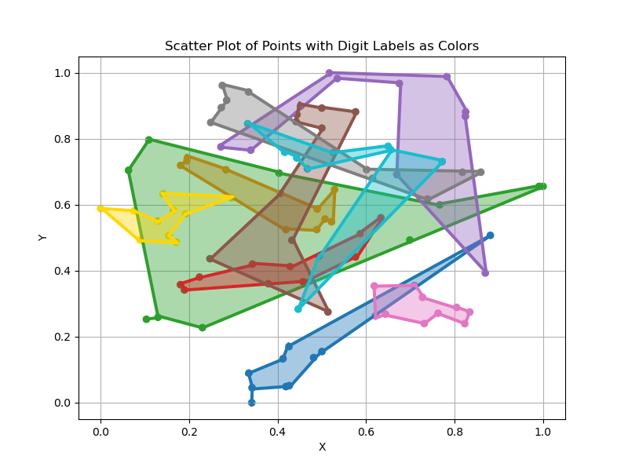
Manual Mapping
For 9

Slide 33
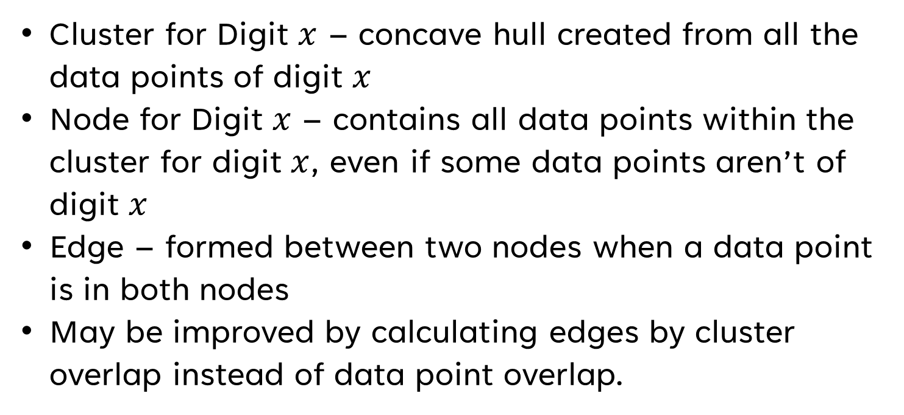
Manual Mapping
Cluster for Digit $x$ – concave hull created from all the data points of digit $x$
Node for Digit $x$ – contains all data points within the cluster for digit $x$, even if some data points aren’t of digit $x$
Edge – formed between two nodes when a data point is in both nodes
May be improved by calculating edges by cluster overlap instead of data point overlap.

Slide 34
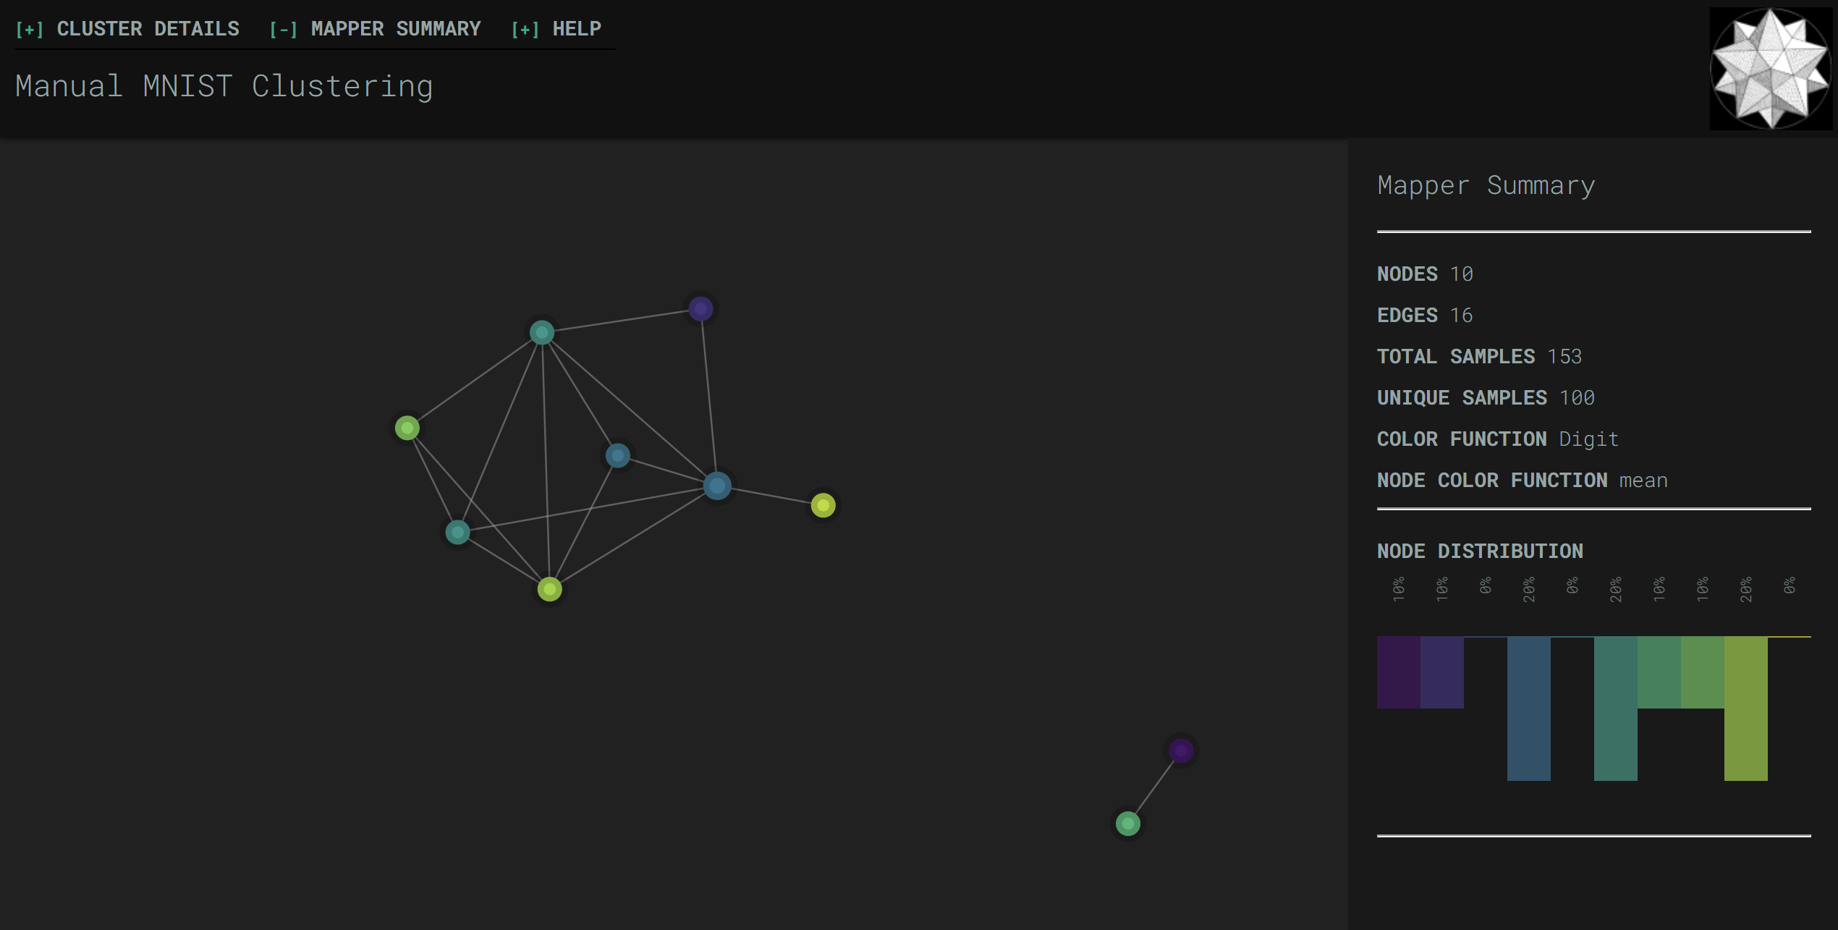
Manual Mapping
Notes:
- Kind of like a ground truth

Slide 35
Automatic Mapping
KeplerMapper provides covering scheme
Each dimension spanned by hypercubes
Adjacent cubes have % of overlap
Hypercubes per dimension and % of overlap are parameters

Slide 36
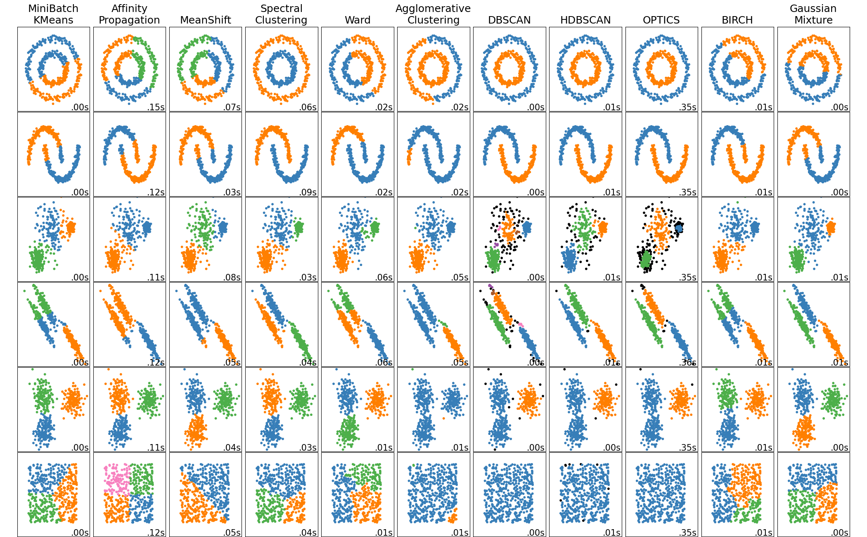
Automatic Mapping
Many different clustering algorithms, each with different strengths and use cases.
DBSCAN worked best for us.
Spectral Clustering looks promising.
Notes:
Picture from https://scikit-learn.org/stable/modules/clustering.html

Slide 37
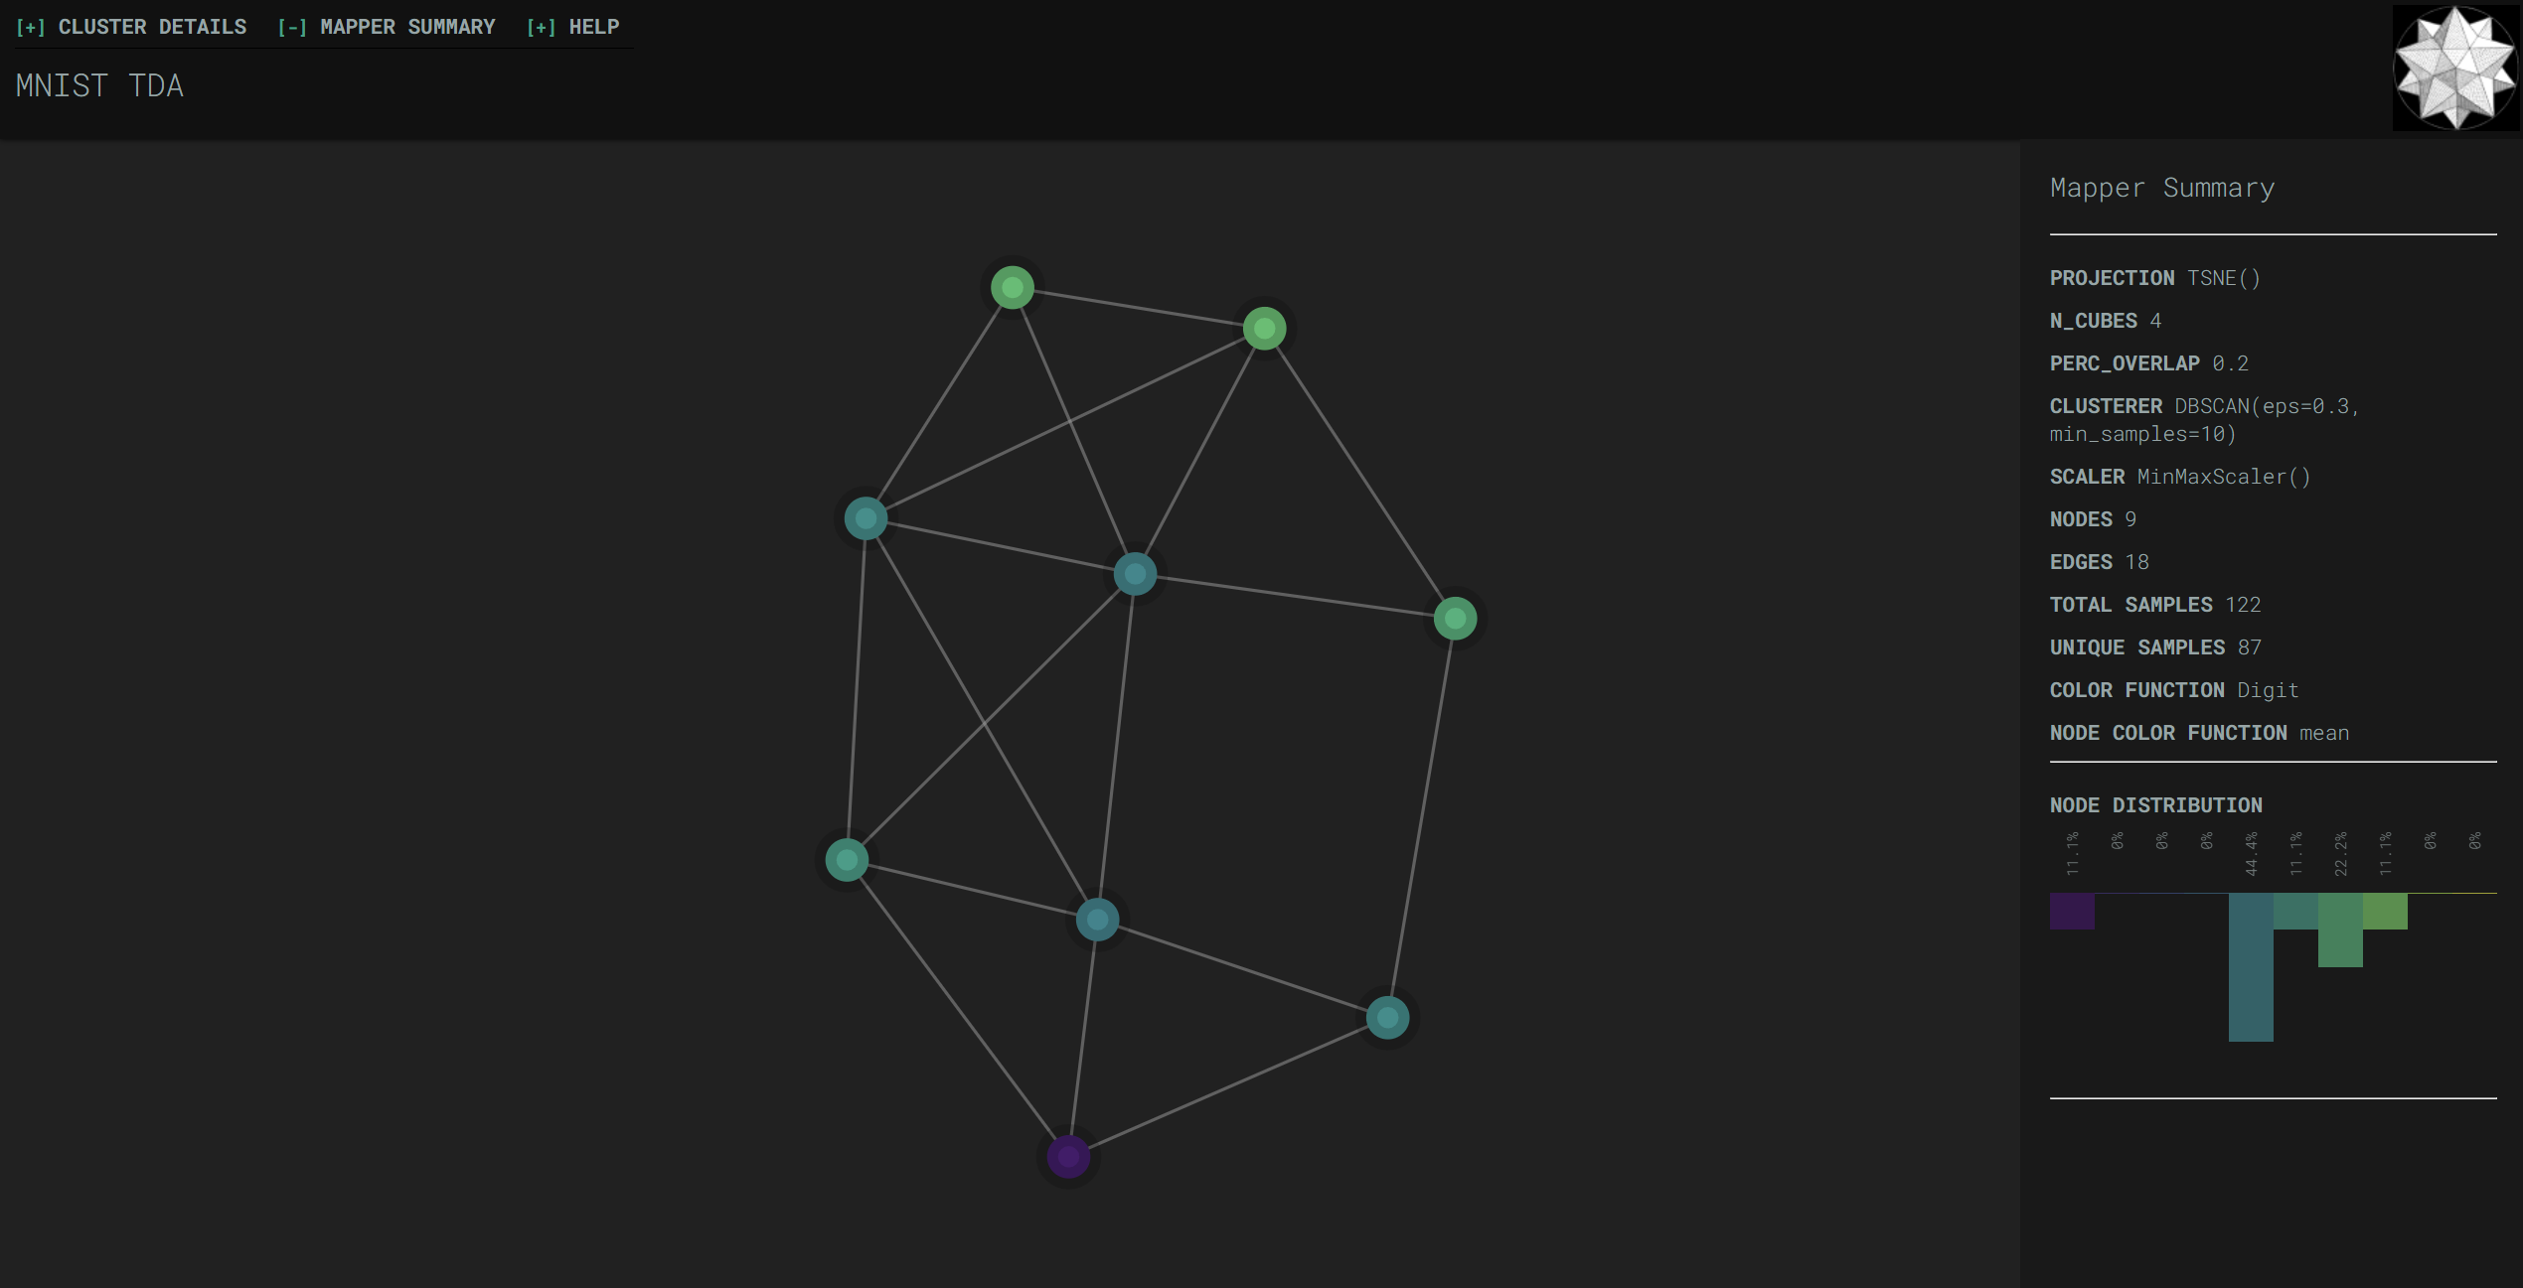
Automatic Mapping

Slide 38

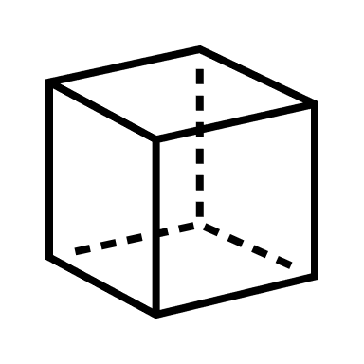
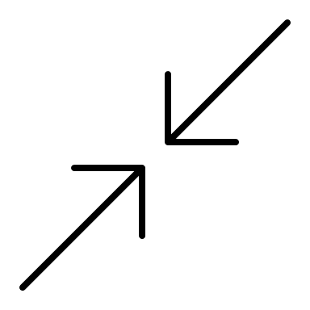


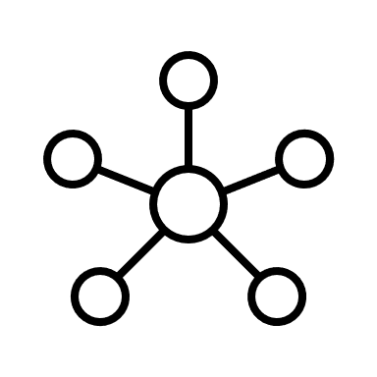
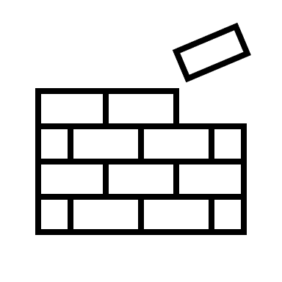
Data Pipeline
Selection
Reshaping
Raw Keras MNIST Data
Selected & Reshaped Data
x_train = array(60000,28,28)
y_train = array(60000,)
data = array(100,784)
labels = array(100,)
Dimension
Reduction
Scaling
Projected Data
data = array(100,784)
labels = array(100,)
projected_data = array(100,2)
Graph
Creation
Cover
Clustering
Graph
data = array(100,784)
labels = array(100,)
projected_data = array(100,2)
graph = dict(nodes,links,…)

Slide 39
Interesting Findings
0 and 6 typically close on the scatter plot but no overlap
9 has large cluster (similar topology to many digits) and almost never overlap with 0 or 6
5 and 4 typically close to 9 on the scatter plot
Both 1 and 3 typically within 2’s cluster
9 and 7 typically close on the scatter plot
All of this could change with different/more data, but consistent across lenses/projection pipelines!

Slide 40

THANK YOU
Interactive HTML files,
Jupyter Notebook w/ code,
Project proposal,
Presentation file, etc.
Notes:
QR links to https://github.com/LumaDevelopment/ArtificialIntelligence/tree/main/GraduateProject

